Slide 1

CSE 3521: Introduction to Artificial Intelligence
[These slides are partially adapted from the UC Berkeley. CS188 Intro to AI at UC Berkeley]

Slide 2

Administrative Details
HW_0 is published
*** Ungraded ***

Slide 3

Administrative Details
Post questions about each week in the carmen weekly discussions

Slide 4
Administrative Details
Post questions about each week in the carmen weekly discussions
Slide contents, references, recorded lectures will be updated after each class

Slide 5


Slide 6
Recap
Description of AI (and intelligent agent)
Description of an AI agent
PEAS description

Slide 7
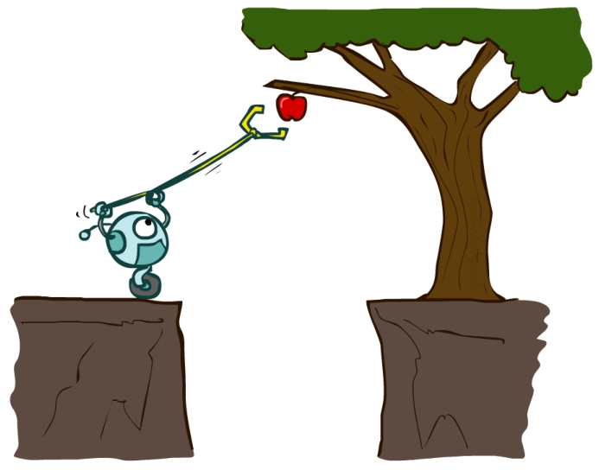
AI – Agents and Environments
Much (though not all!) of AI is concerned with agents operating in environments.
Agent – an entity that perceives its environment through sensors and acts upon that environment through effectors (actuators)
Environment – the problem setting

Slide 8
AI – Agents and Environments
Much (though not all!) of AI is concerned with agents operating in environments.
Agent – an entity that perceives its environment through sensors and acts upon that environment through effectors (actuators)
Environment – the problem setting

Slide 9
AI – Agents and Environments
Much (though not all!) of AI is concerned with agents operating in environments.
Agent – an entity that perceives its environment through sensors and acts upon that environment through effectors (actuators)
Environment – the problem setting

Slide 10
Kinds of Environments
Six common properties to distinguish environments (not exhaustive)
Fully observable vs Partially observable
Single agent vs Multiagent
Deterministic vs Stochastic
Episodic vs Sequential
Static vs Dynamic
Discrete vs Continuous

Slide 11
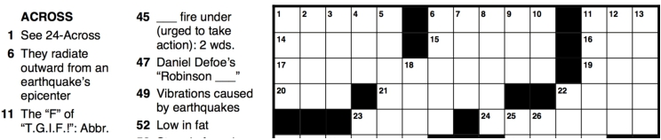

Fully Observable vs Partially Observable
Fully observable
Agent is able to sense everything in the environment
Partially observable
noisy, inaccurate, or incomplete sensors
Notes:
Puzzle vs Poker

Slide 12
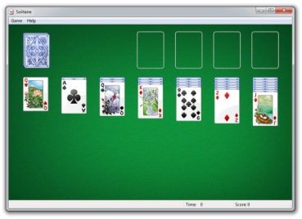

Single Agent vs Multiagent
Single Agent
Self-explanatory
Multiagent
Task involves more than one agent
Each with its own performance measure
May be competitive (measures are opposed) or cooperative (measures are aligned)
Notes:
Solitare vs autonomous driver

Slide 13
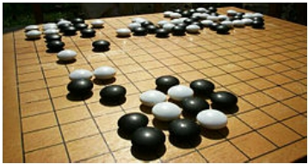
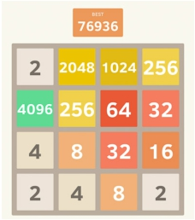
Deterministic vs Stochastic
Deterministic
Next state of the world is fully determined by current state + agent action
Stochastic
it’s not deterministic
https://2048game.com/
Notes:
pinnacle game
2048 is a single-player sliding block puzzle game designed by the Italian web developer Gabriele Cirulli. The game's objective is to slide numbered tiles on a grid to combine them to create a tile with the number 2048.
Stochastic: you don’t’ know where the next “2” will show up

Slide 14

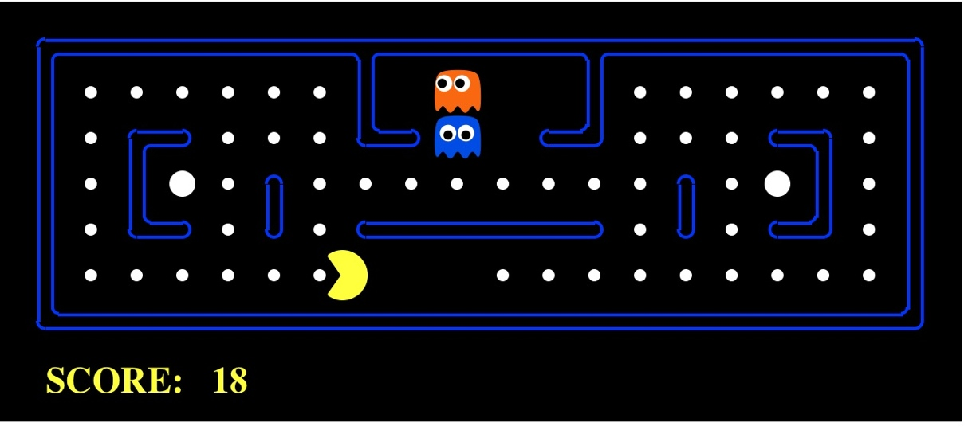

Episodic vs Sequential
Episodic
Each step’s state/decision is independent of the previous ones
Sequential
Each step’s state/decision affects later ones

Slide 15
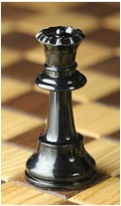

Static vs Dynamic
Static
world doesn’t change while agent is choosing an action
Dynamic
decision time matters!
Notes:
Chase vs production

Slide 16
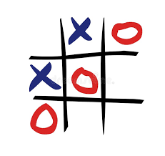

Discreet vs Continuous
Discrete
Possible states/actions are distinct; world changes discretely
Continuous
states/actions take on continuous values
Notes:
Tic-tac-toe vs car driving

Slide 17
These help to find how to approach a problem
Static: focus on getting really high accuracy/utility
Dynamic: trade some utility for higher efficiency (speed!)
Episodic: reflex agent with a great model
Sequential: need a goal oriented agent
Stochastic: need robustness to uncertainty/failure (robots!)
Deterministic: can focus on efficiency and exactness (Internet crawler)

Slide 18
Examples
 | Crossword puzzle | Taxi Driving
Observability
Deterministic vs Stochastic
Episodic vs Sequential
Static vs Dynamic
Discrete vs Continuous
Single vs Multi Agent
Fully
Deterministic
Sequential
Static
Discrete
Single
Partially
Stochastic
Sequential
Dynamic
Continuous
Multi

Slide 19
Examples
 | Crossword puzzle | Taxi Driving
Observability
Deterministic vs Stochastic
Episodic vs Sequential
Static vs Dynamic
Discrete vs Continuous
Single vs Multi Agent
Fully
Deterministic
Sequential
Static
Discrete
Single
Partially
Stochastic
Sequential
Dynamic
Continuous
Multi

Slide 20
Examples
 | Crossword puzzle | Taxi Driving
Observability
Deterministic vs Stochastic
Episodic vs Sequential
Static vs Dynamic
Discrete vs Continuous
Single vs Multi Agent
Fully
Deterministic
Sequential
Static
Discrete
Single
Partially
Stochastic
Sequential
Dynamic
Continuous
Multi

Slide 21

Search

Slide 22
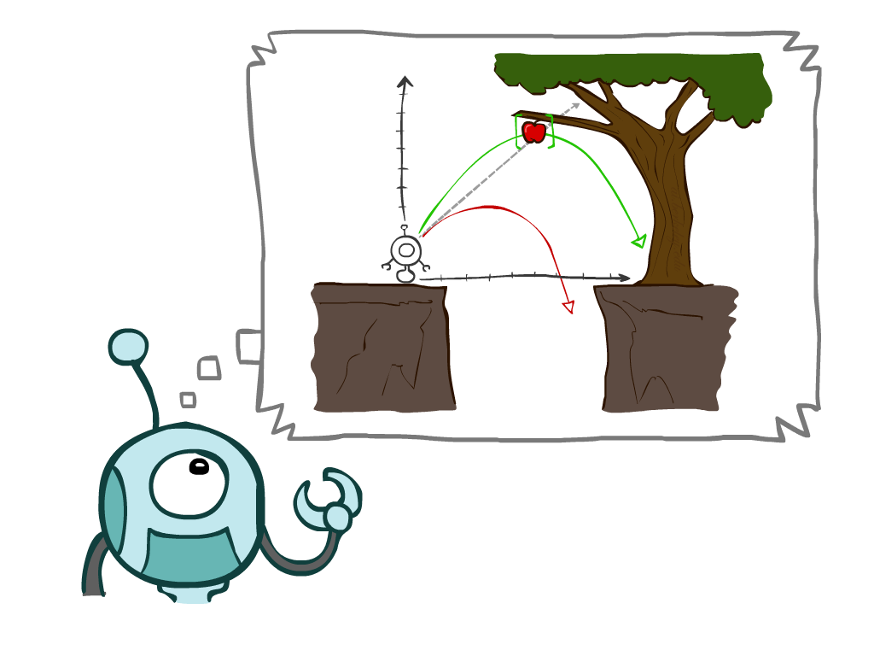
Search Types
Types
Uninformed Search Methods
Depth-First Search
Breadth-First Search
Uniform-Cost Search
Informed Search Methods
Greedy Search
A* Search
Graph searches
Notes:
General theme in the class:
A goal we have in mind.
A mathematical abstraction to formalize this
Algorithms that operate on these abstractions

Slide 23
Agents that Plan Ahead
Planning agents:
Ask “what if”
Decisions based on (hypothesized) consequences of actions
Must have a model of how the world evolves in response to actions
Must formulate a goal (test)
Consider how the world WOULD BE
Optimal vs. complete planning

Slide 24
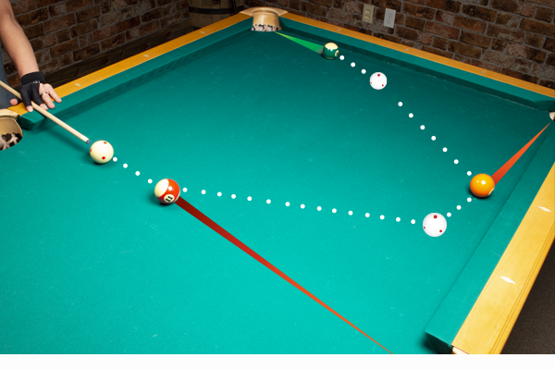
Agents that Plan Ahead
Before taking real actions in the real environment, formulate an off-line problem in a simulated/imaginary environment (model).
The off-line problem:
Has a goal (test)/desired state(s): not necessary the same as the real problem
To find a sequence of actions that can achieve the goal, better with optimal cost/performance measure/utility
Execute the action sequence in the real environment
Execute the first action in the sequence, see how to state changes, and may re-plan!
Notes:
pool

Slide 25

Search Problems
A systematic way to looking for the (optimal) action sequence to reach goal
Not the only way

Slide 26

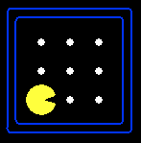





Search Problems
A search problem consists of:
A state space
A successor function
(with actions, costs)
A start state and a goal test
A solution is a sequence of actions (a plan) which transforms the start state to a goal state
“N”, 1.0
“E”, 1.0

Slide 27
Search Problems
A search problem consists of:
A state space
A successor function
(with actions, costs)
A start state and a goal test
A solution is a sequence of actions (a plan) which transforms the start state to a goal state
“N”, 1.0
“E”, 1.0

Slide 28
Search Problems
A search problem consists of:
A state space
A successor function
(with actions, costs)
A start state and a goal test
A solution is a sequence of actions (a plan) which transforms the start state to a goal state
“N”, 1.0
“E”, 1.0

Slide 29
Search Problems
A search problem consists of:
A state space
A successor function
(with actions, costs)
A start state and a goal test
A solution is a sequence of actions (a plan) which transforms the start state to a goal state
“N”, 1.0
“E”, 1.0

Slide 30
Example: Traveling in Romania
State space:
Cities
Successor function:
Roads: Go to adjacent city with cost = distance
Start state:
Arad
Goal test:
Is state == Bucharest?
Solution?
If there exists one, it is a sequence of cities from Arad to Bucharest

Slide 31
Example: Traveling in Romania
State space:
Cities
Successor function:
Roads: Go to adjacent city with cost = distance
Start state:
Arad
Goal test:
Is state == Bucharest?
Solution?
If there exists one, it is a sequence of cities from Arad to Bucharest

Slide 32
Example: Traveling in Romania
State space:
Cities
Successor function:
Roads: Go to adjacent city with cost = distance
Start state:
Arad
Goal test:
Is state == Bucharest?
Solution?
If there exists one, it is a sequence of cities from Arad to Bucharest

Slide 33
Example: Traveling in Romania
State space:
Cities
Successor function:
Roads: Go to adjacent city with cost = distance
Start state:
Arad
Goal test:
Is state == Bucharest?
Solution?
If there exists one, it is a sequence of cities from Arad to Bucharest

Slide 34
Example: Traveling in Romania
State space:
Cities
Successor function:
Roads: Go to adjacent city with cost = distance
Start state:
Arad
Goal test:
Is state == Bucharest?
Solution?
If there exists one, it is a sequence of cities from Arad to Bucharest

Slide 35
Example: Traveling in Romania
State space:
Cities
Successor function:
Roads: Go to adjacent city with cost = distance
Start state:
Arad
Goal test:
Is state == Bucharest?
Solution?
If there exists one, it is a sequence of cities from Arad to Bucharest

Slide 36
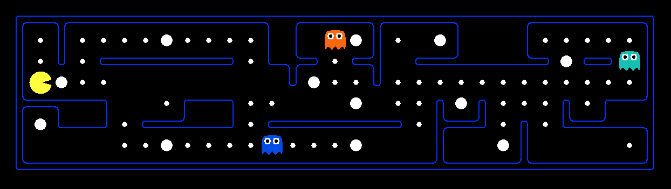
What’s in a State Space?
The world state includes every last detail of the environment
A search state keeps only the details needed for planning (abstraction)
Problem: Pathing
States: (x,y) location
Actions: NSEW
Successor: update location only
Goal test: is (x,y)=END
Problem: Eat-All-Dots
States: {(x,y), dot booleans}
Actions: NSEW
Successor: update location and possibly a dot boolean
Goal test: dots all false

Slide 37
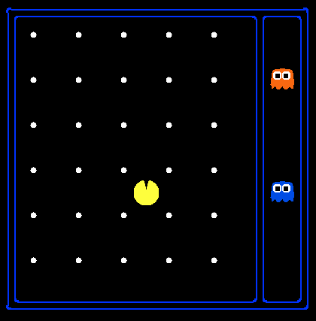
State Space Sizes?
World state:
Agent positions: 120
Food count: 30
Ghost positions: 12
Agent facing: NSEW
How many
World states?
120x(2³⁰)x(12²)x4
States for pathing?
120
States for eat-all-dots?
120x(2³⁰)
Notes:
90 * (2^30-1) + 30 * 2^29 = 145 billion
2^29 = 536 870 912

Slide 38
State Space Sizes?
World state:
Agent positions: 120
Food count: 30
Ghost positions: 12
Agent facing: NSEW
How many
World states?
120x(2³⁰)x(12²)x4
States for pathing?
120
States for eat-all-dots?
120x(2³⁰)
Notes:
90 * (2^30-1) + 30 * 2^29 = 145 billion
2^29 = 536 870 912

Slide 39
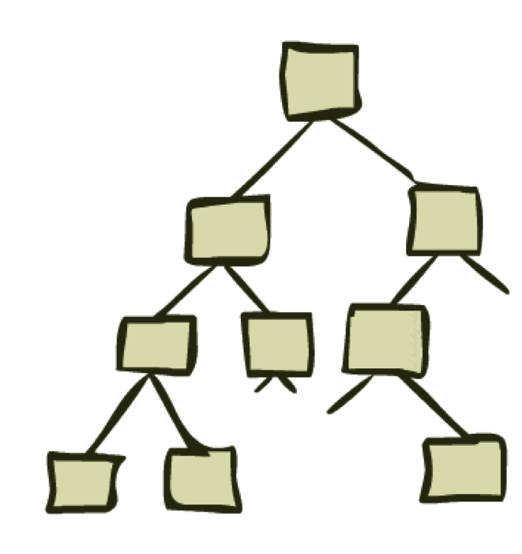
State Space Graphs and Search Trees
To “systematically” find the solution rather than brute-force

Slide 40
State Space Graphs
State space graph: A mathematical representation of a search problem
Nodes are (abstracted) world configurations
Arcs represent successors (action results)
The goal test is a set of goal nodes (maybe only one)
In a state space graph, each state occurs only once!
We can rarely build this full graph in memory (it’s too big), but it’s a useful idea
a
G
b
c
e
d
f
S
h
p
q
r
Tiny state space graph graph for a tiny search problem

Slide 41
State Space Graphs
State space graph: A mathematical representation of a search problem
Nodes are (abstracted) world configurations
Arcs represent successors (action results)
The goal test is a set of goal nodes (maybe only one)
In a state space graph, each state occurs only once!
We can rarely build this full graph in memory (it’s too big), but it’s a useful idea
a
G
b
c
e
d
f
S
h
p
q
r
Tiny state space graph graph for a tiny search problem

Slide 42
State Space Graphs
State space graph: A mathematical representation of a search problem
Nodes are (abstracted) world configurations
Arcs represent successors (action results)
The goal test is a set of goal nodes (maybe only one)
In a state space graph, each state occurs only once!
We can rarely build this full graph in memory (it’s too big), but it’s a useful idea
a
G
b
c
e
d
f
S
h
p
q
r
Tiny state space graph graph for a tiny search problem

Slide 43
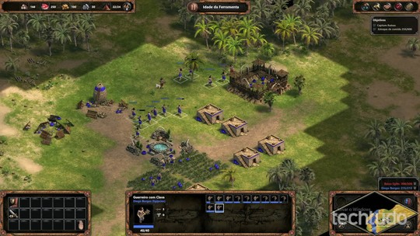
Search Trees
This is now / start
“N”, 1.0
“E”, 1.0
Possible futures
A search tree:
A “what if” tree of plans and their outcomes
The start state is the root node
Children correspond to successors
Nodes show states, but correspond to PLANS that achieve those states
For most problems, we can never actually build the whole tree
Notes:
Different plans that achieve the same state, will be different nodes in the tree.

Slide 44
Search Trees
This is now / start
“N”, 1.0
“E”, 1.0
Possible futures
A search tree:
A “what if” tree of plans and their outcomes
The start state is the root node
Children correspond to successors
Nodes show states, but correspond to PLANS that achieve those states
For most problems, we can never actually build the whole tree
Notes:
Different plans that achieve the same state, will be different nodes in the tree.

Slide 45
Search Trees
This is now / start
“N”, 1.0
“E”, 1.0
Possible futures
A search tree:
A “what if” tree of plans and their outcomes
The start state is the root node
Children correspond to successors
Nodes show states, but correspond to PLANS that achieve those states
For most problems, we can never actually build the whole tree
Notes:
Different plans that achieve the same state, will be different nodes in the tree.

Slide 46
Search Trees: nodes are not states but partial plans
a
(a)
a
b
(b-c)
b
c
c
(a-b-c)
(a-b-c-G)
G
a
(a-b-c-a)
G
Can we have “a” again? Or should it go back the root (then not a tree anymore)?
Different plans that achieve the same state, will be different nodes in the tree!
Yes! The node is actually (a-b-c-a), different from (a).
Notes:
Different plans that achieve the same state, will be different nodes in the tree.

Slide 47
State Space Graphs vs. Search Trees
State Space Graph
Each NODE in in the search tree is an entire PATH in the state space graph.
Search Tree
S
a
G
d
e
p
b
c
q
b
c
e
h
r
d
e
f
a
a
h
r
p
q
f
S
h
We construct both on demand – and we construct as little as possible.
p
q
f
q
c
G
p
q
r
q
c
G
a
a

Slide 48
Exercise: State Space Graphs vs. Search Trees
Consider this 4-state graph:
a
S
G
b
How big is its search tree (from S)?

Slide 49

Exercise: State Space Graphs vs. Search Trees
Consider this 4-state graph:
a
S
G
b
Important: Lots of repeated structure in the search tree!
How big is its search tree (from S)?

Slide 50
Search Example: Romania

Slide 51
Searching with a Search Tree
Search:
Expand out potential plans (tree nodes)
Maintain a fringe of partial plans under consideration
Try to expand as few tree nodes as possible

Slide 52
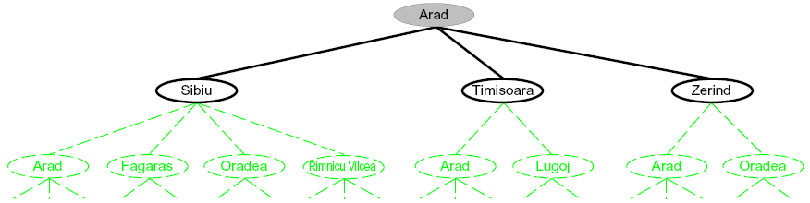
Searching with a Search Tree
Search:
Expand out potential plans (tree nodes)
Maintain a fringe of partial plans under consideration
Try to expand as few tree nodes as possible

Slide 53
Searching with a Search Tree
Search:
Expand out potential plans (tree nodes)
Maintain a fringe of partial plans under consideration
Try to expand as few tree nodes as possible

Slide 54
General Tree Search
Important components: (1) Fringe (2) Expansion (3) Exploration strategy
Main question: which fringe nodes to explore?

Slide 55
Uninformed vs. Informed Search
Uninformed search
Given no information about problem (other than its definition)
Find solutions to problems by systematically generating new states and testing for goal
Informed search
Given some ideas of where to look for solutions
Use problem-specific knowledge

Slide 56
Uninformed vs. Informed Search
Uninformed search
Given no information about problem (other than its definition)
Find solutions to problems by systematically generating new states and testing for goal
Informed search
Given some ideas of where to look for solutions
Use problem-specific knowledge

Slide 57
Example: Tree Search
a
G
b
c
e
d
f
S
h
p
r
q

Slide 58

Depth-First Search

Slide 59
Depth-First Search
a
G
a
Strategy: expand a deepest node first
Implementation: Fringe is a LIFO stack
c
b
c
b
e
d
e
d
f
f
S
h
h
p
p
r
q
r
q
S
d
e
p
b
c
e
h
r
q
a
a
h
r
p
q
f
p
q
f
q
c
G
q
c
G
a
a

Slide 60
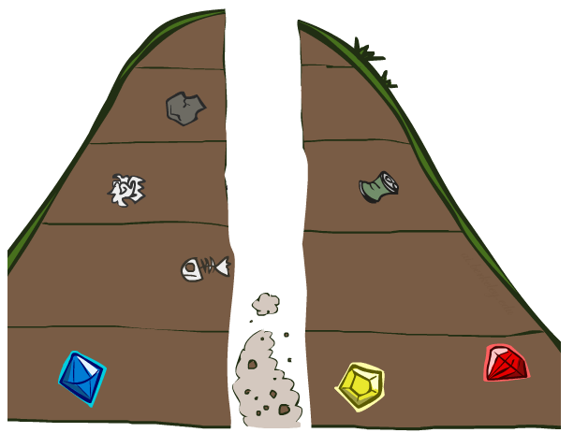
Search Algorithm Properties

Slide 61
Search Algorithm Properties
Complete: Guaranteed to find a solution if one exists?
Optimal: Guaranteed to find the least cost path?
Time complexity?
Space complexity (fringe)?
Cartoon of search tree:
b is the branching factor
m is the maximum depth
solutions at various depths
Number of nodes in entire tree?
1 + b + b² + …. b^{m} = O(b^{m})
1 node
b
…
b nodes
b² nodes
m tiers
b^{m} nodes

Slide 62
Depth-First Search (DFS) Properties
What nodes DFS expand?
Some left prefix of the tree.
Could process the whole tree!
If m is finite, takes time O(b^{m})
How much space does the fringe take?
Only has siblings on the current path to root, so O(bm)
Is it complete?
m could be infinite, so only if we prevent cycles
Is it optimal?
No, it finds the “leftmost” solution, regardless of depth or cost
1 node
b
…
b nodes
b² nodes
m tiers
b^{m} nodes

Slide 63
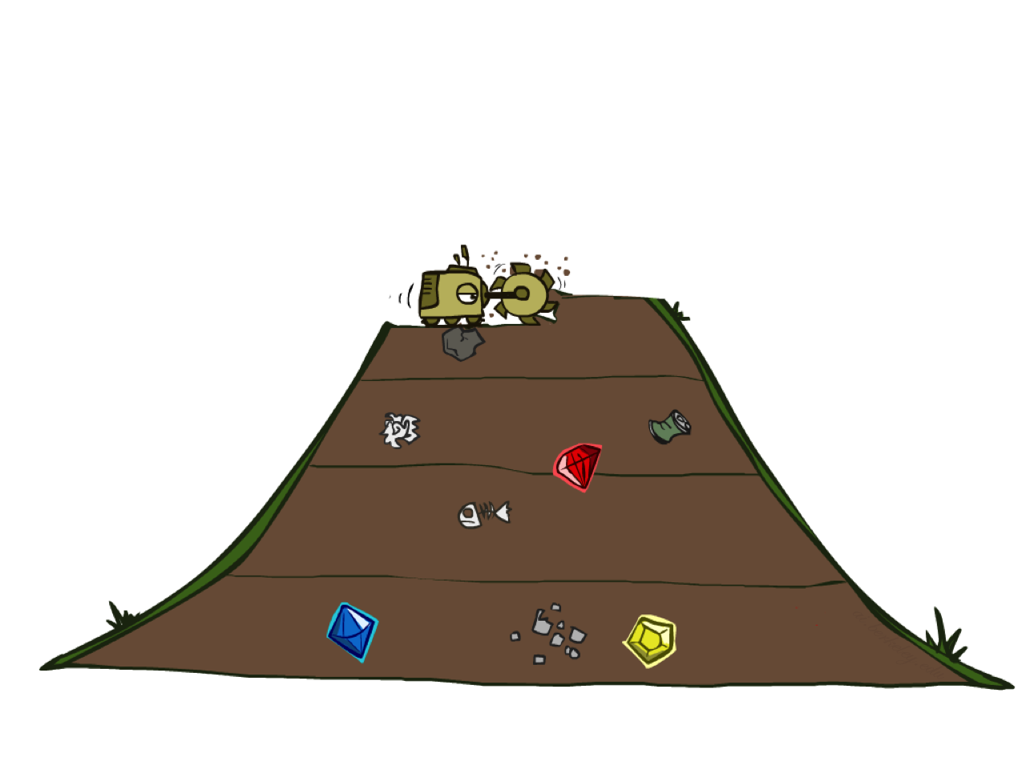
Breadth-First Search

Slide 64
Breadth-First Search
Strategy: expand a shallowest node first
Implementation: Fringe is a FIFO queue
a
G
b
c
d
e
f
S
h
p
q
r
S
d
e
p
Search
Tiers
b
c
e
h
r
q
a
a
h
r
p
q
f
p
q
f
q
c
G
q
c
G
a
a

Slide 65
Breadth-First Search (BFS) Properties
What nodes does BFS expand?
Processes all nodes above shallowest solution
Let depth of shallowest solution be s
Search takes time O(b^{s})
How much space does the fringe take?
Has roughly the last tier, so O(b^{s})
Is it complete?
s must be finite if a solution exists, so yes!
Is it optimal?
Only if costs are all 1 (more on costs later)
1 node
b
…
b nodes
s tiers
b² nodes
b^{s} nodes
b^{m} nodes

Slide 66
Iterative Deepening
Idea: get DFS’s space advantage with BFS’s time / shallow-solution advantages
Run a DFS with depth limit 1. If no solution…
Run a DFS with depth limit 2. If no solution…
Run a DFS with depth limit 3. …..
Isn’t that wastefully redundant?
Generally most work happens in the lowest level searched, so not so bad!
A Preferred method with large search space and depth of solution not known
b
…

Slide 67
Cost-Sensitive Search
a
GOAL
2
2
b
c
3
2
1
8
2
e
d
f
3
9
8
2
START
h
1
4
2
p
4
r
15
q
BFS finds the shortest path in terms of number of actions.
It does not find the least-cost path. We will now cover
a similar algorithm which does find the least-cost path.

Slide 68

Uniform Cost Search (UCS)

Slide 69
Uniform Cost Search (USC)
2
G
a
Strategy: expand a cheapest node first:
Fringe is a priority queue (priority: cumulative cost)
b
c
1
8
2
2
e
3
d
f
9
8
2
S
h
1
1
p
q
r
15
0
S
d
3
e
9
p
1
b
4
e
5
h
17
r
11
q
16
c
11
Cost contours
a
6
a
h
13
r
7
p
q
f
p
q
f
8
q
c
G
q
c
a
11
G
10
a

Slide 70
Uniform Cost Search (UCS) Properties
What nodes does UCS expand?
Processes all nodes with cost less than cheapest solution!
If that solution costs C* and arcs cost at least ε , then the “effective depth” is roughly C*/ε
Takes time O(b^{C*/ε}) (exponential in effective depth)
Additional cost of priority queue
How much space does the fringe take?
Has roughly the last tier, so O(b^{C*/ε})
Is it complete?
Assuming best solution has a finite cost and minimum arc cost is positive, yes!
Is it optimal?
Yes!
b
c ≤ 1
…
C*/ε “tiers”
c ≤ 2
c ≤ 3

Slide 71
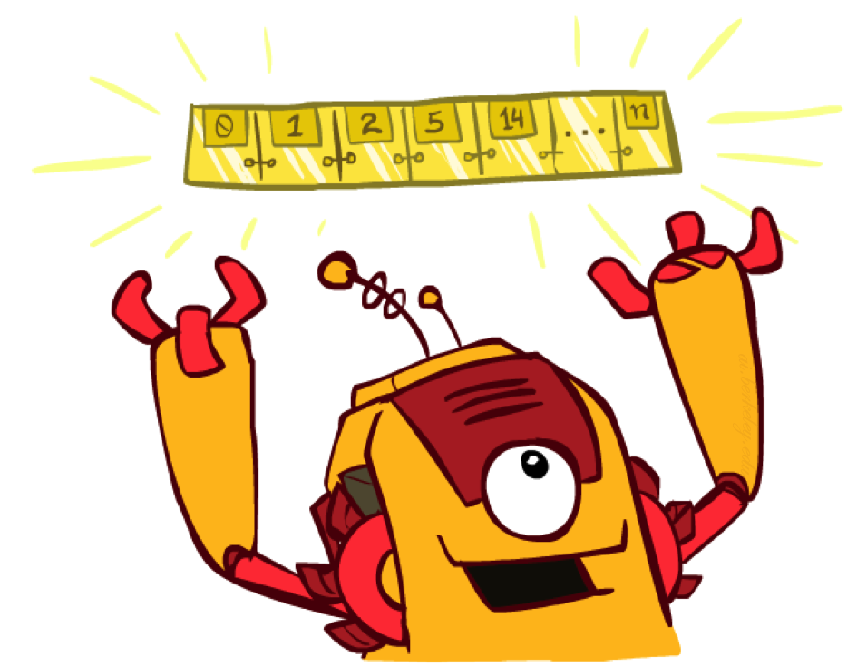
The One Queue
All the search algorithms are the same except for fringe/exploration strategies
Conceptually, all fringes are priority queues (i.e. collections of nodes with attached priorities)
Practically, for DFS and BFS, you can avoid the log(n) overhead from an actual priority queue, by using stacks and queues
Can even code one implementation that takes a variable queuing object

Slide 72
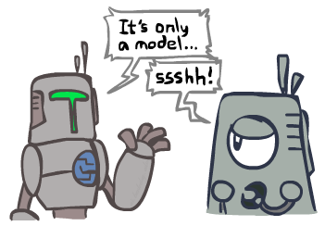
Search and Models
Search operates over models of the world
The agent doesn’t actually try all the plans out in the real world!
Planning is all “in simulation”
Your search is only as good as your models…

Slide 73
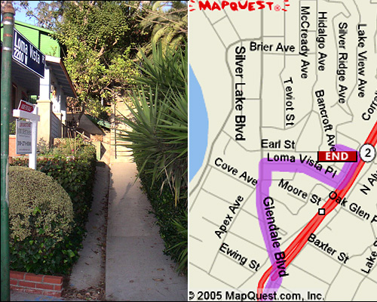
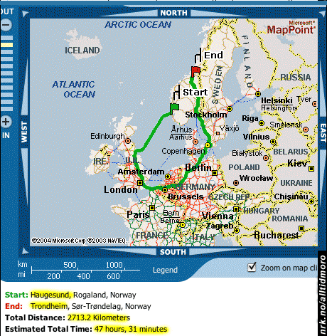

Search Gone Wrong?

Slide 74
A Quick Summary: Search
Search problem:
States (configurations of the world)
Actions and costs
Successor function (world dynamics)
Start state and goal test
Search tree:
Nodes: represent plans for reaching states
Plans have costs (sum of action costs)
Search algorithm:
Systematically builds a search tree
Chooses an ordering of the fringe (unexplored nodes)
Optimal: finds least-cost plans

